Slide 1

An asynchronous JavaScript library to control remote embedded devices [JavaScript, Promise, Arduino]
Week 3 Presentation

Slide 2
Progress
Over the past week I have
Initialized the git repositories required.
Re-implemented the functionality of the previous years project as a base point to work from.
Read materials regarding ‘espruino’, ‘uart.js’ & ’puck.js’
Investigated an overhaul of the ’uart.js’ library which hasn’t been updated in 2 years and doesn’t support typescript.
Explored issue management systems like azure devops and jira
Investigated appropriate CI/CD for the projects.

Slide 3
Problems
Whilst looking at last years implementation I noticed it uses md5 hashing
I noticed there is no string manipulation done to this before hand and no removal of function initializer.
why is this a problem ()=>console.log(“123”) is identical to function(){console.log(‘123’)}
Other examples of this are “ ” is equal to ’ ’ is equal to ` ` so if somebody initializes
Const my_func = () => console.log(“Hello”) // this is different in the eyes of md5 to function my_func(){console.log(“Hello”) // which is different to function my_func(){ console.log(“Hello”) } even trailing commas would appear different.

Slide 4
How will I fix this?
I am going to investigate fully sanitizing these strings of code to remove \n, \t, spaces, all quotations.
A further problem I will encounter will be the difference between const x = () => {} and function x(){} and const x = function(){} this will require further investigation to resolve.

Slide 5
Whats next?
overhauling ‘uart.js’ to better fit my needs.
further explore the commands available within the espruino sytem i.e. LED1.set() or setWatch()
implement primitive commands for lesser experienced users to work straight off with the ability to run direct espruino.js code through device.write() commands.
Implement device specific commands like ‘puck.onPress()’
Explore publishing an npm package & npx tool
explore ssg tools such as hugo, Jekyll, nextjs, Gatsby for documentation
Design and implement the online environment taking inspiration for the espruino IDE.
Implement correct issue management and CI/CD to github repo (I have discussed different methods to do this with my employer)
Explore testing
Develop an easy to use directory for the npx tool and explore potential tags for cli

Slide 6
Explanation of Decisions (so far)
Why Typescript?
Why reimplement uart.js?
Why NPX tool?

Slide 7
Typescript
Typescript allows for strict static typing on javascript.
Typescript enforces good coding practices by showing the developer errors at developing time rather than run time.
Typescript provides syntax suggestions during development to remove the guessing when it comes to objects, this could be helpful for users unfamiliar with the syntax.
Typescript builds directly into javascript allowing for both javascript and typescript users to use the package as intended.
sidenote: typescript can compile into any desired version of javascript. So if you want to use the es2019 > 'abbbaab'.replaceAll('b', 'x’) //'axxxaax’ method typescript could compile this to es5 to be compatible with all browsers not just ones that support the newest js versions

Slide 8
Re-implementing UART.js
UART is not written in typescript so bringing it in line with what the rest of the project uses would be a benefit.
further this would allow for customization of the UI, i.e. changing the ugly connection modal.
This will provide a better understanding of the system.
This would also allow me to document my new uart.js package to keep everything in one place.

Slide 9
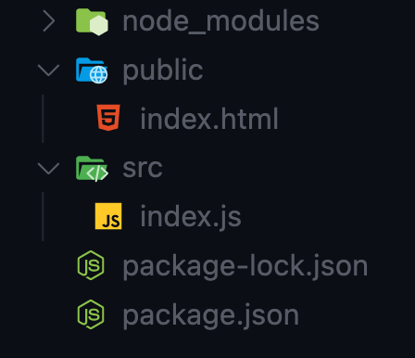
NPX Tool
an npx tool would allow for easy creation of a ready to work local environment.
This would work like so… in terminal a user would type:
‘>~ npx create-espruino-tool-app’
This would run all the necessary commands and create a base directory ready to code as shown in image.
This would have optional flags like
(--typescript, --vue, --react) to create
familiar environments for users

